Slide 1
Simon’s Algorithm
Finding periodicity of a function
不正经讲师：理科宅Hunt

Slide 2

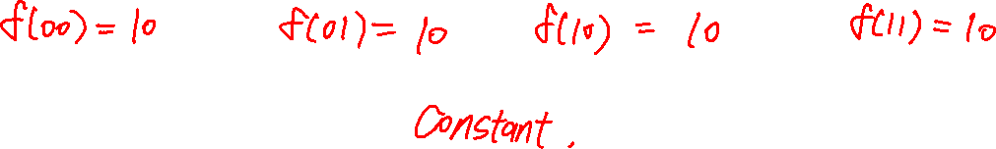
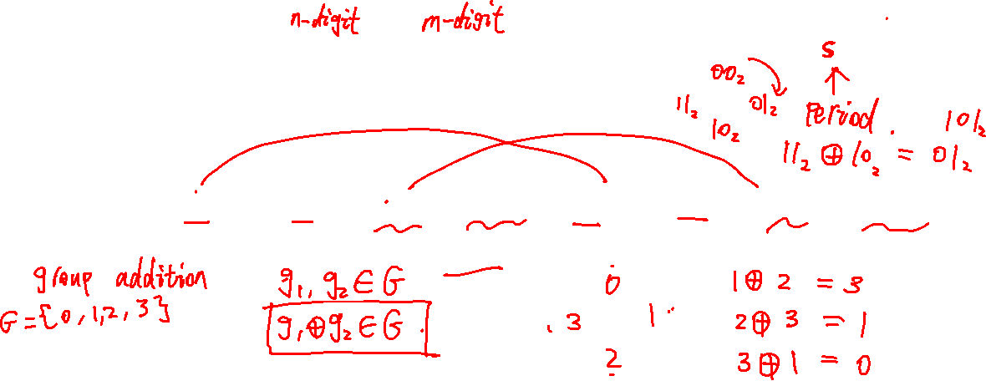
Periodic function
A function, $f:\{0,1\}^{n}→{\left\{0,1\right\}}^{m}$, is periodic if there exists $s∈\{0,1\}^{n}$ such that $f\left(x⊕s\right)=f\left(x\right), ∀x∈{\left\{0,1\right\}}^{n}$.
Example: A function has the following values
$$f\left({00}_{2}\right)={10}_{2}, f\left({01}_{2}\right)={01}_{2}, f\left({10}_{2}\right)={10}_{2}, f\left({11}_{2}\right)={01}_{2}$$
This function has period $s={10}_{2}$ since $f\left(x⊕s\right)=f(x)$ for all x.

Slide 3

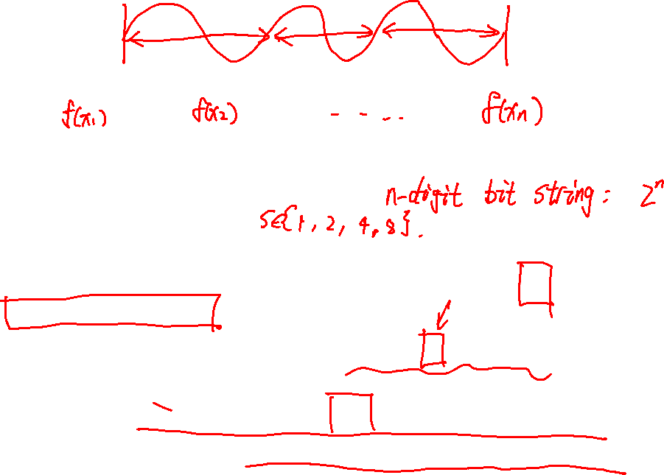
Classical Algorithm that find the periodicity
I will make a simple but natural algorithm:
Calculate all $f\left(x\right)$ and record them.
Suppose $f$ is periodic, then its period must divide $2^{n}$. So, there are $n$ possible periods.
For each possible period, check if $f\left(x⊕s\right)=f(x)$ for all $x$.
In this algorithm, we need to make $2^{n}$ function evaluations(step 1).
In quantum computing, we do less than $n$ function evaluations.

Slide 4
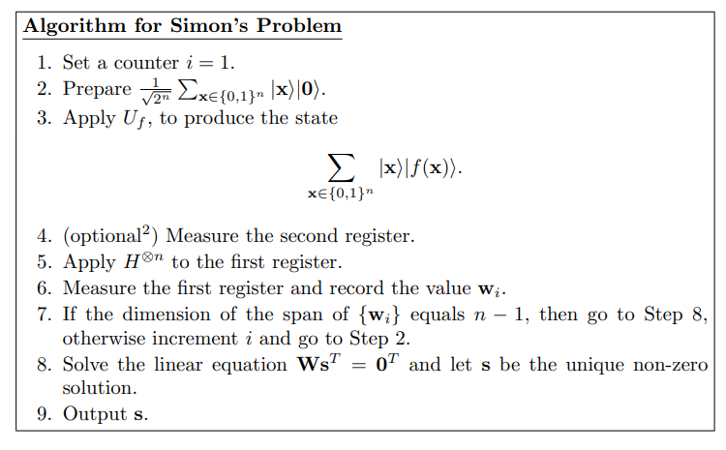
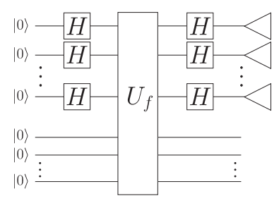

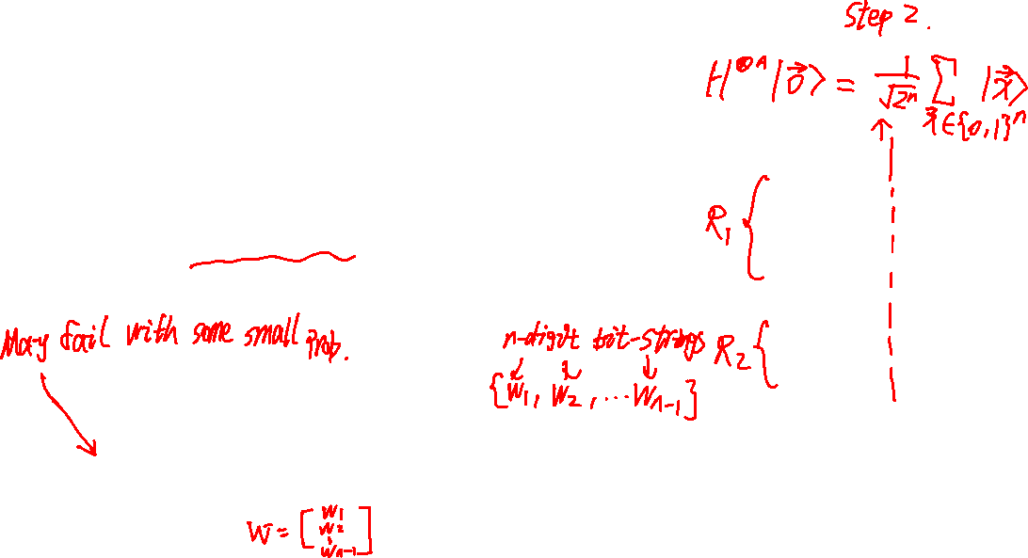
Simon’s Algorithm

Slide 5
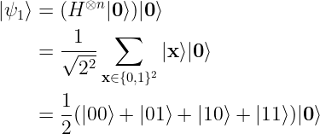




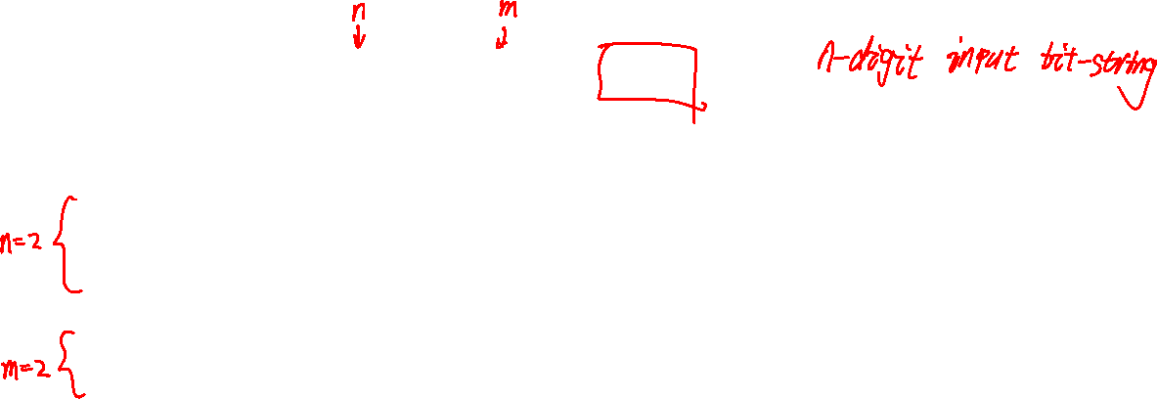

Example – Step 1 and 2 (Prepare states)
Suppose $f:{\left\{0,1\right\}}^{2}→{\left\{0,1\right\}}^{2}$, then $n=2$.
Set counter $i=1$.
$$|ψ_{0}⟩$$
$$|ψ_{1}⟩$$
$$|ψ_{2}⟩$$
$$|ψ_{3}⟩$$

Slide 6
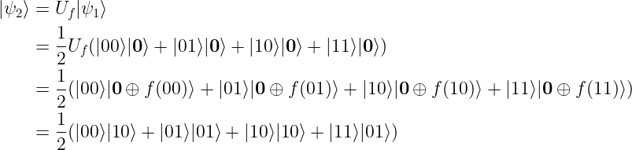





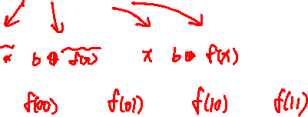

Example – Step 3 (Function evaluation)
Let $f:{\left\{0,1\right\}}^{2}→{\left\{0,1\right\}}^{2}$ be defined as
$$f\left({00}_{2}\right)={10}_{2}, f\left({01}_{2}\right)={01}_{2}, f\left({10}_{2}\right)={10}_{2}, f\left({11}_{2}\right)={01}_{2}$$
$$|ψ_{0}⟩$$
$$|ψ_{1}⟩$$
$$|ψ_{2}⟩$$
$$|ψ_{3}⟩$$

Slide 7
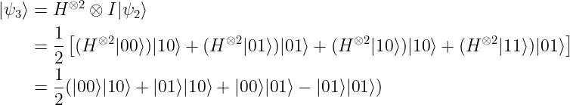
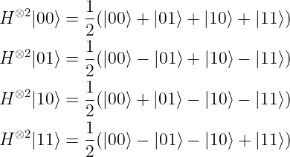


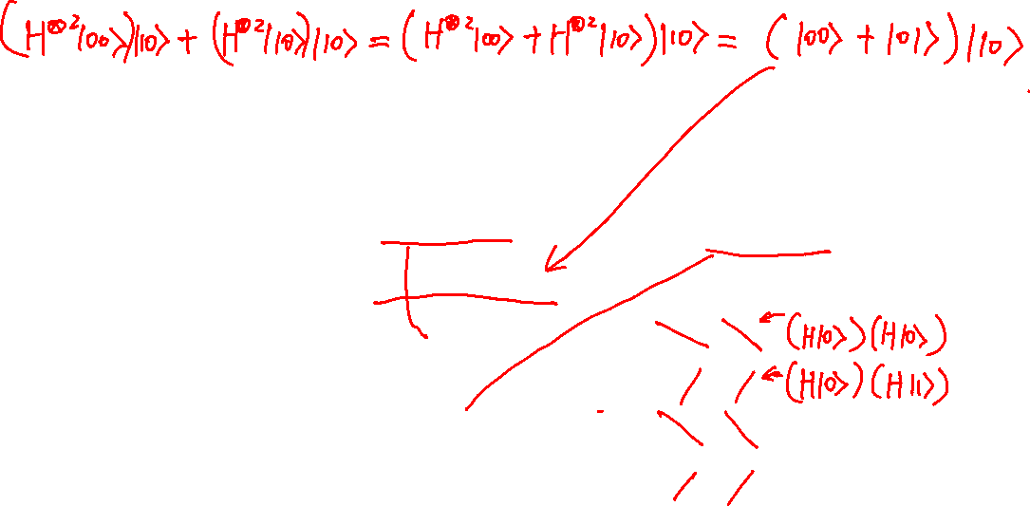


Example – Step 5 (Hadamard gates on 1st register)
You can get rid of the second register, this makes the calculation easier. This is what the optional in the algo step does.
$$|ψ_{0}⟩$$
$$|ψ_{1}⟩$$
$$|ψ_{2}⟩$$
$$|ψ_{3}⟩$$

Slide 8






Example – Step 6 (Measurements)
No matter what the second register is, we have 1/2 probability of getting $\left|00\right\rangle ,\left|01\right\rangle$ on the first register.
1/2 prob
1/2 prob
$$|ψ_{0}⟩$$
$$|ψ_{1}⟩$$
$$|ψ_{2}⟩$$
$$|ψ_{3}⟩$$

Slide 9

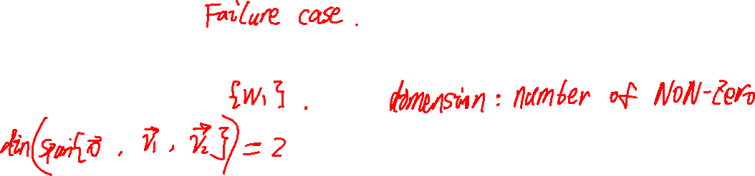
Example – Step 7 (Measurements)
If we measured $w_{1}=00$, then $dim\left\{w_{1}\right\}=0$, we need to repeat previous steps again.
If we measure $w_{1}=01$, then $dim\left\{w_{1}\right\}=n−1=1$, we can proceed to next step.
Textbook did not explain the definition of dimension of a bit string. You can simply think that the dim of zero-bit is 0 and 1 otherwise.

Slide 10


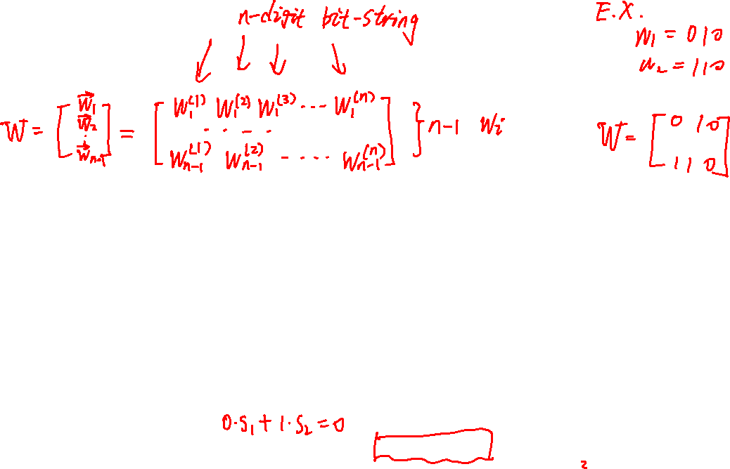
Example – Step 8 (Solve $Ws^{T}=0^{T}$)
Remember that every bit string is a ROW vector.
$W=\left[w_{1}\right]=[0,1]$ is a $1×2$ matrix
$s^{T}={\left[s_{1}, s_{2}\right]}^{T}=\left[\begin{aligned}s_{1} \\ s_{2}\end{aligned}\right]$ where s1 and s2 are the two digits of $s$.
In textbook, $0^{T}$ is a $\left(n−1\right)×1$ column vector (not the zero bit). This is quite confusing. So, in this example, $0^{T}=0$ is just a binary number 0.
Solve the linear system and take the NON-ZERO solution.

Slide 11

Time complexity of Simon’s Algorithm
In this algorithm, we $O(n)$ function evaluations.
Solving $Ws^{T}=0^{T}$ takes $O(n^{3})$ steps if you use Gaussian elimination.

Slide 12
Summary
Simon’s algorithm significantly reduces the time complexity of period finding, from exponential to polynomial.

